Slide 1
DIGITAL SYSTEMS PROJECT · CAPSTONE REVIEW
Automatic Street Light Control System
Design, Logic Synthesis, and Logisim Simulation
Team members:
2620030286 Shaan Inampudi · 2620030283 KALAKUNTLA ANUDEEP RAO
2620030251 MAKKENA SRI SAI CHARAN · 2620030287 GUNDA BHAARGAV
Section - 14· Digital Design and Computer Architecture
Notes:
Welcome to our project presentation. We designed and simulated an automatic street light control system that switches lamps on only during darkness and dims them when no motion is detected. Today we present the sensing model, truth table logic, circuit synthesis, and Logisim simulation.

Slide 2
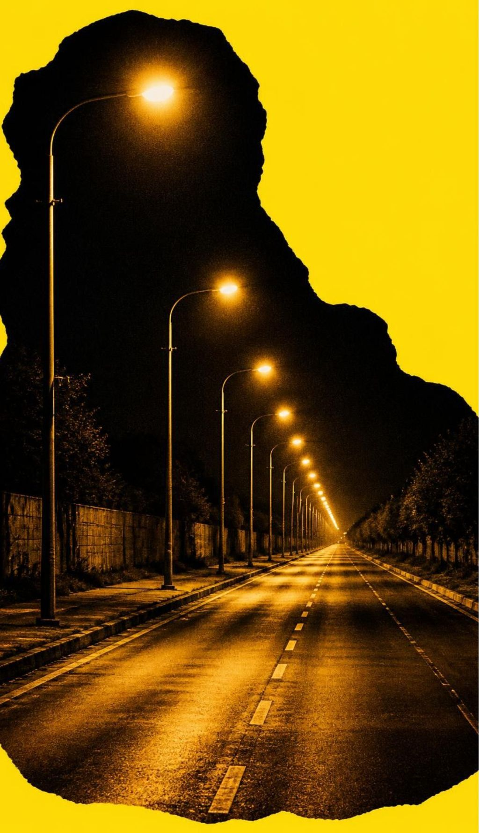
PROBLEM STATEMENT & OBJECTIVE
Streets burn power all night, whether anyone needs them or not
Conventional street lamps operate on fixed mechanical timers or manual switches, wasting massive municipal power during early dusk, empty post-midnight hours, and dawn.
Energy waste: Lights run at 100% capacity on completely vacant roadways.
Primary objective: Keep the lamp OFF in daylight, DIM at night, and boost to FULL brightness only when vehicles or pedestrians pass.
Method & verification: Pair LDR light sensing and PIR motion detection with combinational logic, verified in simulation before building hardware.
02
Notes:
Our core motivation is eliminating wasted roadway power. Conventional lights burn full power for ten to twelve hours straight. Our objective is closed-loop autonomy: darkness turns the fixture on to an energy-saving dim level, and human or vehicle motion triggers full illumination.

Slide 3
SYSTEM ARCHITECTURE
How the system works: sense, decide, switch
A continuous feedforward path from environmental sensors to high-efficiency power drivers.
01
02
03
04
1. Sensing Layer
2. Conditioning
3. Logic / Controller
4. Power Driver
LDR tracks ambient lux; PIR sensor scans a 120° field for infrared radiation changes caused by movement.
Voltage divider and op-amp comparator digitize the LDR signal into clean high/low binary levels.
Combinational gates or an ATmega328P evaluate inputs against set thresholds to select the operating state.
An NPN power transistor or 5V relay module switches high current and modulates PWM output to the LED luminaire.
POWER DISTRIBUTION: Regulated 5V DC rail supplies sensors, logic gates, and the microcontroller core.
03
Notes:
Here is the four-stage system pipeline. The ambient light and motion sensors gather environmental data, signal conditioning turns the analog LDR resistance into clean digital bits, the logic core evaluates state conditions, and a power driver controls the lamp at dim or full brightness.

Slide 4


Boolean Equations & Implementation
BOOLEAN LOGIC SYNTHESIS
The overall lamp activation condition requires darkness regardless of motion:
Two sensor bits decide the lamp
Let when ambient conditions are dark, and when motion is detected.
Decomposing the power levels into individual gating channels:
D (DARK) | M (MOTION) | LAMP MODE | OUTPUT LEVEL
0 | 0 | Day / Idle | OFF (0%)
0 | 1 | Day / Motion | OFF (0%)
1 | 0 | Night / Idle | DIM (30%)
1 | 1 | Night / Motion | FULL (100%)
Universal gate conversion:
By De Morgan's laws, the circuit can be fabricated entirely from two-input NAND gates, simplifying physical IC footprint.
04
Notes:
This truth table forms the foundation of our circuit. Notice that motion during daylight produces zero lamp output, preserving power. When dark, motion selects 100% brightness while lack of motion holds the lamp at a 30% dim standby.

Slide 5
HARDWARE SPECIFICATIONS
Components and operational ratings
Standardized electronic components selected for simulation modeling and benchtop prototyping.
COMPONENT | SUBSYSTEM ROLE | ELECTRICAL SPECIFICATIONS | SIGNAL TYPE
LDR (Photoresistor) | Daylight detection | Dark R > 1\,\text{M}\Omega; Light R \approx 1\text{--}10\,\text{k}\Omega | Analog voltage
PIR HC-SR501 | Occupancy tracking | 3.3V logic high; 3–7 m range; 120° aperture | Digital TTL
Arduino Uno (MCU) | Threshold evaluation | ATmega328P, 16 MHz, 10-bit ADC, 6 PWM pins | Digital / PWM
NPN / 5V Relay | Load switching | 2N2222 transistor or 10A/250VAC SPDT relay | Switched DC
High-Power LED | Luminaire output | 1W–10W LED with current-limiting series resistor | PWM brightness
05
Notes:
We chose widely documented, cost-effective components. The LDR swings from megohms in total darkness to a few kilohms in sunlight. The PIR module provides an active-high 3.3V pulse on motion. The Arduino or discrete logic drives our power transistor to modulate the LED array safely.

Slide 6




STATE MACHINE & FLOWCHART
Control logic flowchart and transition loop
A three-state finite state machine continuously evaluates inputs in a non-blocking loop.
01
02
03
04
STEP 01
DECISION 01
DECISION 02
DRIVE STATE
Sample LDR
Is it Dark?
Motion Sensed?
Drive Luminaire
Measure voltage across the potential divider network.
If , ambient is daylight: execute State 0 (Lamp OFF) and loop back.
If dark, read PIR pin . Check if moving thermal mass is within range.
triggers State 2 (FULL 100%); maintains State 1 (DIM 30%).
FSM State Encoding: S0 = 00 (OFF), S1 = 01 (DIM), S2 = 10 (FULL). The controller holds in S1 during quiet night hours.
Hysteresis Protection: A software debounce delay prevents rapid oscillation at the dusk/dawn light boundary.
06
Notes:
This flowchart maps directly to our software loop or hardware state register. Notice how the primary branch bifurcates: if it is daylight, the PIR sensor is bypassed completely, eliminating nuisance triggers from daytime pedestrian traffic.

Slide 7

LOGISIM SCHEMATIC ARCHITECTURE
Circuit design in Logisim
Modular digital schematic implementing combinational gating, state registers, and multiplexed PWM control.
INPUT BLOCK
GATING & TIMING
OUTPUT STAGE
Sensor Conditioners
Logic & Monostable
MUX & LED Matrix
1-bit input models the thresholded LDR comparator; 1-bit input models the PIR pulse.
AND and NOT gates compute raw terms. A clock-driven register and counter hold motion high for a 5-second stretch.
A 4:1 multiplexer selects between constant 0, 30% duty cycle, and 100% DC power lines into the probe LED.
Configurable pull-down logic
Prevents instant turn-off
Clean digital simulation probe
Scalable System Bus: These exact discrete Logisim functional blocks map 1:1 to memory-mapped GPIO registers in an open-source RISC-V SoC implementation.
07
Notes:
In Logisim, we built the complete digital core. We used a comparator subcircuit for the LDR threshold, an inverter and AND gates for term generation, a timer register to prevent flickering when motion pauses briefly, and a multiplexer to route the correct brightness code to the LED probe.

Slide 8
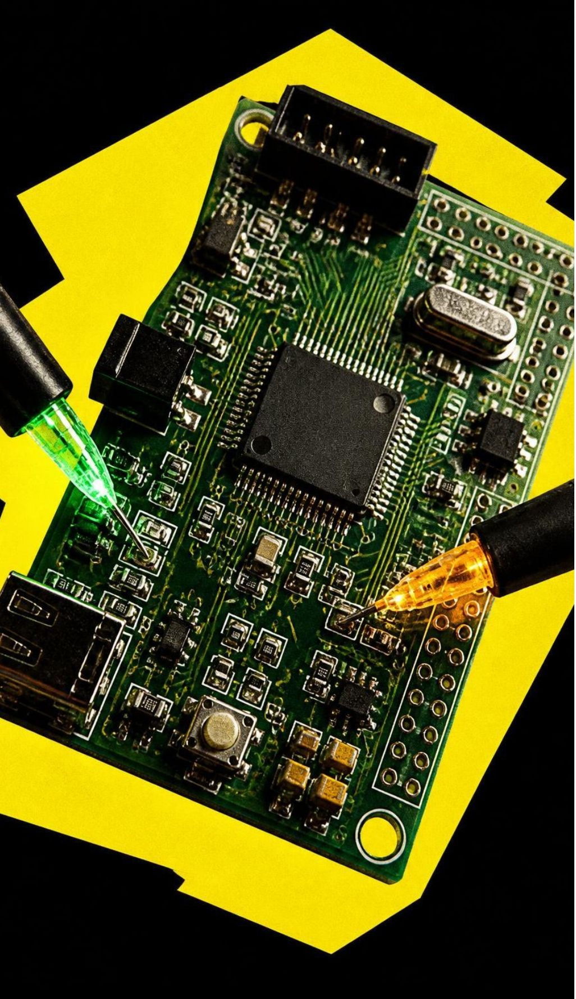
SIMULATION PROTOCOL
Simulation setup and test conditions
Structured verification across two software environments ensures full state-space coverage.
Dual-Platform Testing
Logisim verifies gate propagation delays and truth-table state vectors; Tinkercad / Proteus models analog resistance sweeps and Arduino MCU firmware execution.
Swept Input Vectors
Simulated light intensity swept from 100 lux (bright day) down to 0.1 lux (night); motion pulses injected at fixed intervals to test timer hold-down.
Formal Pass Criteria
Zero false activations during simulated daylight, steady 30% dim power when idle at night, and latency under 50 ms to hit 100% full brightness upon motion.
08
Notes:
We verified the design using both Logisim for purely digital gate validation and Tinkercad for mixed-signal microcontroller simulation. We tested corner cases, including rapid daylight changes and brief motion bursts, to confirm zero unintended lamp activations.

Slide 9
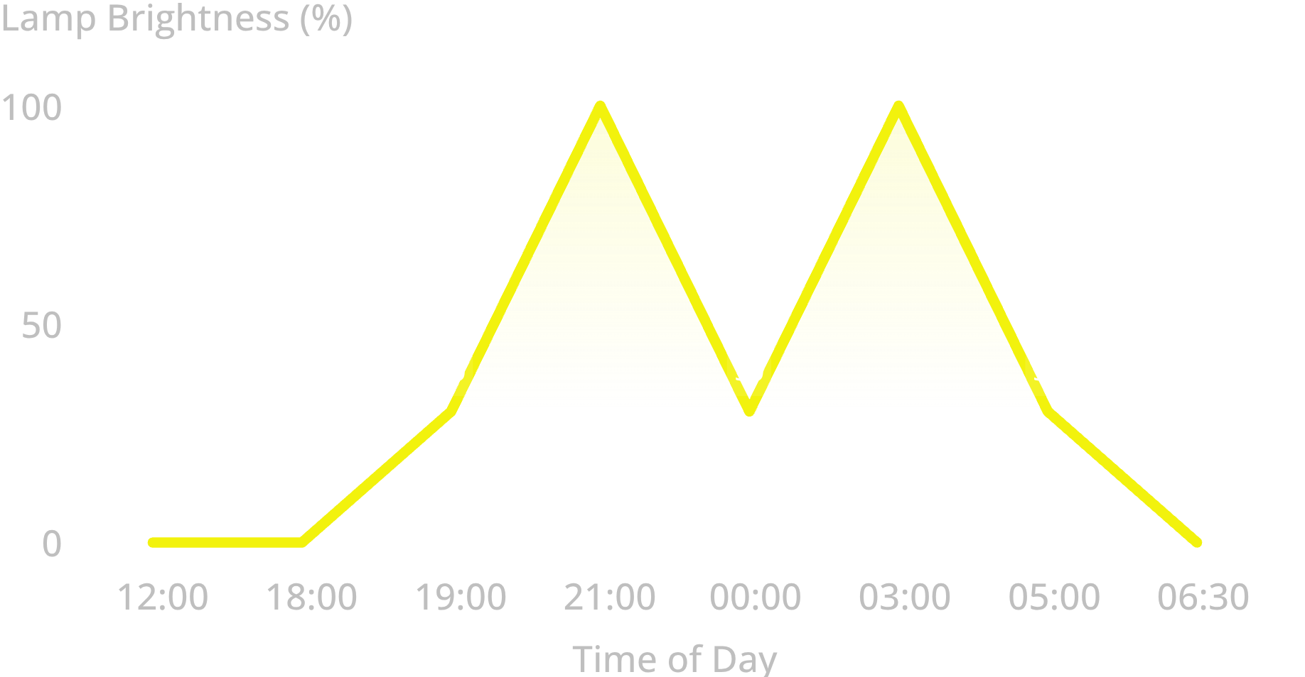
SIMULATION VERIFICATION
Simulation results: lamp output matches the design
Experimental Test Log
All four input combinations verified against the truth table:
Simulated 24-hour diurnal cycle demonstrates targeted power delivery.
AMBIENT LIGHT | MOTION | LAMP OUTPUT
Bright day | No | OFF (0%)
Bright day | Yes | OFF (0%)
Dusk (below threshold) | No | DIM (30%)
Night | No | DIM (30%)
Night | Yes | FULL (100%)
Illustrative simulated test bench run · Logisim & Tinkercad simulation.
09
Notes:
These simulation results prove our control logic holds under realistic conditions. Looking at the graph across 24 hours, the lamp remains completely off all afternoon, triggers to 30% at dusk, leaps to 100% only during detected traffic at 21:00 and 03:00, and shuts off cleanly at sunrise.

Slide 10
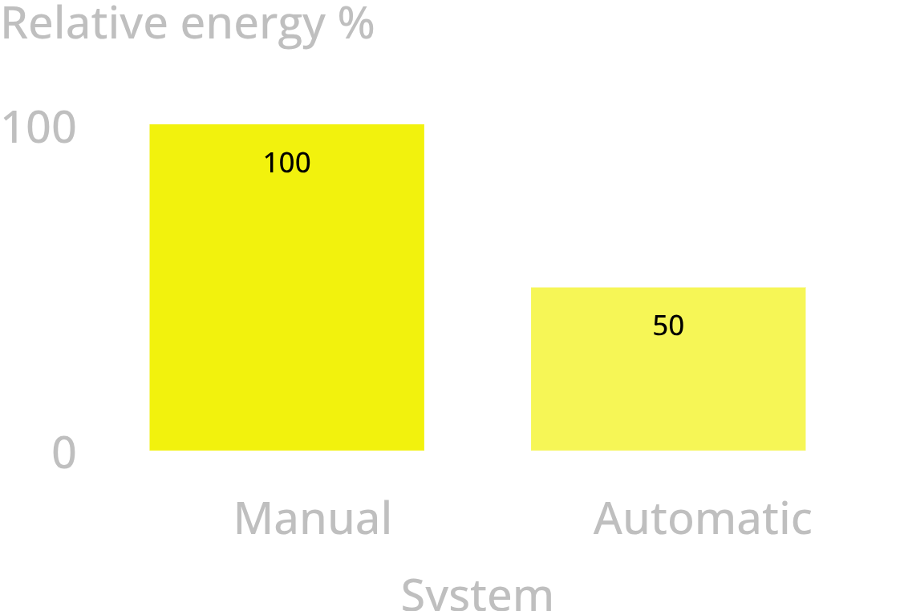
COMPARATIVE ANALYSIS & OUTLOOK
Automatic beats manual; the same logic scales to RISC-V
FACTOR | MANUAL | AUTOMATIC
Energy use | Fixed schedule, full power all night | On only in darkness, dims when idle
Cost | Low install, high running | Higher install, lower running
Maintenance | Manual switching and resets | Self-regulating, longer lamp life
Relative Nightly Energy
Illustrative estimate.
Next step: A RISC-V core drives a memory-mapped LED output, built on gates, FSMs, registers and memory.
10
Notes:
Automatic control saves energy by switching lamps on only when needed and dimming them when empty. The comparison shows relative nightly energy use of 100 for manual and about 50 for automatic (illustrative estimate). The same logic scales to a RISC-V core driving a memory-mapped LED output.

Slide 11
STREET LIGHT CONTROL PROJECT
Thank you
Questions and discussion are welcome.
11
Notes:
Thank the audience, summarize that the system senses, decides, and switches automatically, and open the floor for questions.

